Slide 1
Independent Reading
How do strong readers choose a book? What kind of selection strategies do they engage in?
Recommendations, online reviews, author (past reading/bio), genre, cover, awards, summary on back, seen the movie, read the 1st page, challenging, summer reading table, book reviews.
How will you choose???

Slide 2
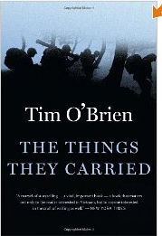
Summer Reading

Slide 3
Classics

Slide 4
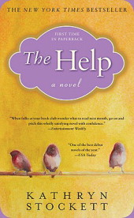
Contemporary

Slide 5
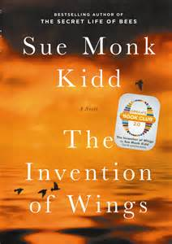
More Contemporary

Slide 6
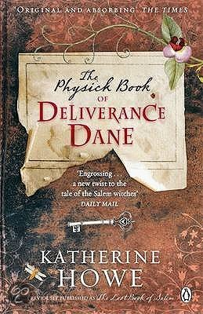
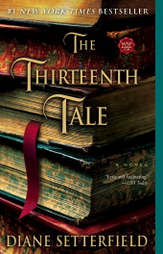
Contemporary

Slide 7
Contemporary

